Slide 1

AWS Web Application Firewall
Comprehensive Protection for Your Web Applications at the Edge

Slide 2
Foundation & Concepts
Understanding the Role of WAF in Modern Security Architecture

Slide 3

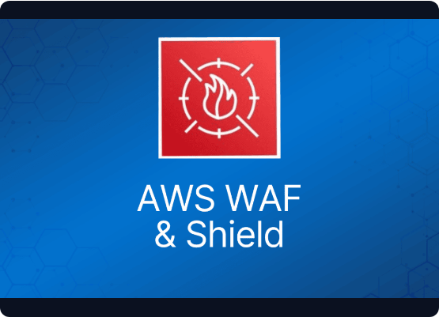

WHAT IS AWS WAF?
AWS WAF is a web application firewall that helps protect your web applications or APIs against common web exploits and bots that may affect availability, compromise security, or consume excessive resources.
Key Value Proposition
Provides granular control over which traffic to allow or block by defining customizable security rules.

Slide 4
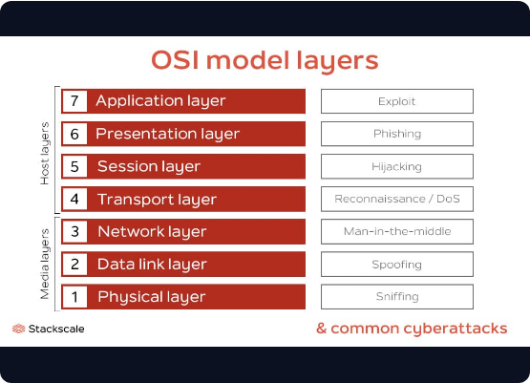
THE NEED FOR LAYER 7 SECURITY
Application Level Filtering: Unlike VPC Security Groups (L3/L4), WAF inspects HTTP/S headers, cookies, and query strings.
OWASP Top 10 Protection: Specifically designed to mitigate SQL Injection (SQLi) and Cross-Site Scripting (XSS).
Payload Inspection: Identifies malicious patterns hidden within application data.

Slide 5
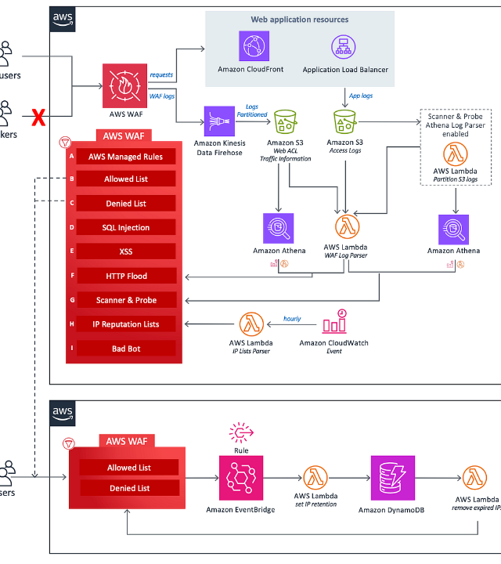
HOW AWS WAF WORKS
AWS WAF sits between the internet and your resources, acting as an intelligent filter for incoming traffic.
Inspects HTTP requests in real-time.
Matches patterns against defined Web ACL rules.
Executes actions based on matches (Allow/Block).

Slide 6






CORE COMPONENTS
Web ACLs
Rules
Rule Groups
The top-level container that groups rules and specifies default actions for a resource.
Individual criteria used to inspect web requests for specific malicious patterns.
Reusable collections of rules that can be applied across multiple Web ACLs for consistency.

Slide 7



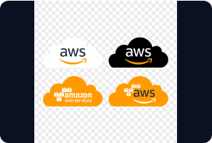

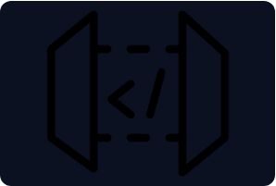
SEAMLESS RESOURCE INTEGRATION
CloudFront
ALB
API Gateway
Filtering traffic at the Edge locations globally.
Protecting applications within specific regions.
Securing REST and WebSocket endpoints.

Slide 8


AWS MANAGED RULES
IP Reputation Lists
Managed Rule Groups are maintained by AWS Security Experts and Marketplace sellers, offering "set and forget" protection.
Leverages Amazon’s global threat intelligence to block known malicious actors and bots.
Core Rule Set (CRS)
Protection against a wide range of common vulnerabilities (OWASP).
Admin Protection
Locks down access to sensitive paths like /admin or /login.

Slide 9
WEB REQUEST ACTIONS
Action | Description | Typical Use Case
Allow | Request is forwarded to the resource. | Traffic from trusted IPs or safe paths.
Block | Terminates the request with 403 Forbidden. | Confirmed malicious patterns (XSS, SQLi).
Count | Logs the request without affecting flow. | Testing new rules before production.
CAPTCHA | Challenges user with a puzzle. | Mitigating suspicious bot behavior.

Slide 10
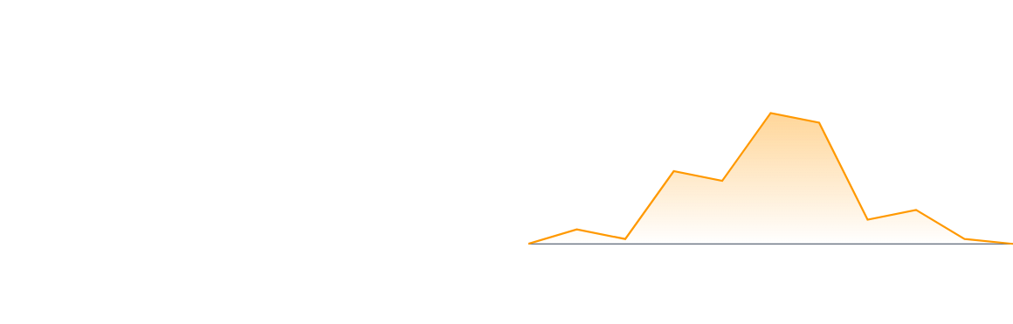
MONITORING & REAL-TIME VISIBILITY
Visibility is provided through CloudWatch Metrics and detailed logging to S3 or Kinesis Firehose.
Track request counts and error rates.
Inspect sampled requests to see rule matches.
Integrate with SIEM for deeper analysis.

Slide 11

INTELLIGENT BOT CONTROL
Defeating Automated Threats
AWS WAF Bot Control uses machine learning to identify and categorize automated traffic in real-time.
100%
Allows "Good Bots" (Search Engines) while blocking "Bad Bots" (Scrapers, credential stuffers).
AUTOMATION INSPECTION

Slide 12
WAF PRICING FUNDAMENTALS
Component | Standard Price | Detail
Web ACLs | $5.00 per month | Per Web ACL per month.
Rules | $1.00 per month | Per rule added to a Web ACL.
Requests | $0.60 per million | Volume-based processing fee.
Managed Rules | Variable | AWS Marketplace fees may apply.
*Pricing is per region and varies for CloudFront (Global).

Slide 13
BEST PRACTICES FOR SUCCESS
Start in Count Mode: Observe how rules affect traffic without blocking legitimate users.
Layered Defense: Use WAF alongside AWS Shield (DDoS) and AWS Firewall Manager.
Automation: Use Infrastructure as Code (Terraform/CDK) to manage Web ACLs.
Rule Optimization: Monitor WCU (Web ACL Capacity Units) to ensure you stay within limits.
Regular Audits: Review logs for false positives and adjust regex patterns accordingly.

Slide 14
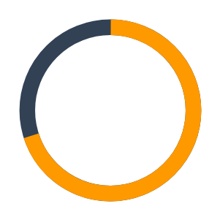
UNIFIED SECURITY STACK
The Shield Strategy
AWS WAF works best as part of a holistic security strategy:
AWS Shield (70%): Absorbs high-volume DDoS attacks at Layers 3/4.
AWS WAF (30%): Filters nuanced application exploits at Layer 7.

